Slide 1
Dinero IV Cache Simulator for Memory Reference Traces
CSCE 5610 Computer Systems Architecture

Slide 2
Dinero IV
Experiments with Dinero IV
Analyze hits/misses with different cache sizes, associativity, structures, prefetch, etc
Obtaining Dinero IV
http://www.cs.wisc.edu/~markhill/DineroIV
Or direct: ftp://ftp.cs.wisc.edu/markhill/DineroIV
Developed by Jan Edler (NEC) and Mark Hill (Madison-Wisconsin)

Slide 3
Dinero IV
Spanish for money (cache – cash – L1$)
Trace driven cache simulator
Given a trace (the history of instruction and data reference of a program) and cache design parameters (such as the block size, unified cache size or instruction cache size and data cache size, associativity of the cache, replacement policy, and write policy),
A trace is a list of the memory references that a program or workload makes while it is executing.

Slide 4
Dinero IV--Installation
Installation && Setup
http://ace.cs.ohio.edu/~avinashk/classes/ee468/tools.htm

Slide 5
Dinero IV
dinero will perform cache simulation and generate the miss rate. For example, the following command:
dinero -b32 -u32K -a1 < eg.din > eg32k.out
perform a cache analysis on 32K unified direct mapped cache with block size=32btyes using a trace input file eg.din and generated output to eg32k.out.
All parameters to dinero can be entered on command line, makes a long command:
dinero -l1-usize 8k -l1-ubsize 4 -l1-uassoc 1 -l1-urepl l -l1-ufetch d -l1-uwalloc a -l1-uwback a -stat-idcombine -informat D
Better option is shell script file, only type once. Also allows easy grouping of experimental parameters

Slide 6
Dinero IV
Some of valid options:
-help Print this help message
-copyright Give details on copyright and lack of warranty
-lN-Tsize P Size
-lN-Tbsize P Block size
-lN-Tsbsize P Sub-block size (default same as block size)
-lN-Tassoc U Associativity (default 1)
-lN-Trepl C Replacement policy
(l=LRU, f=FIFO, r=random) (default l)
-lN-Tfetch C Fetch policy
(d=demand, a=always, m=miss, t=tagged,
l=load forward, s=subblock) (default d)
-lN-Tpfdist U Prefetch distance (in sub-blocks) (default 1)
-lN-Tpfabort U Prefetch abort percentage (0-100) (default 0)
Write allocate policy (a=always, n=never, f=nofetch) (default a)
-lN-Twback C Write back policy (a=always, n=never, f=nofetch) (default a)
-lN-Tccc Compulsory/Capacity/Conflict miss statistics
Command: ./dineroIV -help
Usage: dineroIV [options]
Valid options:

Slide 7
Dinero IV
Notations:
U: unsigned decimal integer S: like U but with optional [kKmMgG] scaling suffix P: like S but must be a power of 2 C: single character A: hexadecimal address F: string N: cache level (1 <= N <= 5) T: cache type (u=unified, i=instruction, d=data)

Slide 8
Dinero IV
Example for Shell script
# This is a large 3-level cache with high associativity
cfg_l1i="-l1-isize 64K -l1-ibsize 64 -l1-isbsize 64 -l1-iassoc 8"
cfg_l1d="-l1-dsize 64K -l1-dbsize 64 -l1-dsbsize 64 -l1-dassoc 8"
cfg_l2u="-l2-usize 512K -l2-ubsize 64 -l2-usbsize 64 -l2-uassoc 8"
cfg_l3u="-l3-usize 4096K -l3-ubsize 64 -l3-usbsize 64 -l3-uassoc 16"
cfg1="$cfg_l1i $cfg_l1d $cfg_l2u $cfg_l3u”
dinero –informat d $cfg1 < tracefile &> cfg1.out
# This is a small 3-level cache with high associativity
cfg_l1i="-l1-isize 16K -l1-ibsize 64 -l1-isbsize 64 -l1-iassoc 8"
cfg_l1d="-l1-dsize 16K -l1-dbsize 64 -l1-dsbsize 64 -l1-dassoc 8"
cfg_l2u="-l2-usize 128K -l2-ubsize 64 -l2-usbsize 64 -l2-uassoc 8"
cfg_l3u="-l3-usize 1024K -l3-ubsize 64 -l3-usbsize 64 -l3-uassoc 16"
cfg2="$cfg_l1i $cfg_l1d $cfg_l2u $cfg_l3u”
dinero –informat d $cfg2 < tracefile &> cfg2.out
# This is a large 3-level cache with low associativity
cfg_l1i="-l1-isize 64K -l1-ibsize 64 -l1-isbsize 64 -l1-iassoc 2"
cfg_l1d="-l1-dsize 64K -l1-dbsize 64 -l1-dsbsize 64 -l1-dassoc 2"
cfg_l2u="-l2-usize 512K -l2-ubsize 64 -l2-usbsize 64 -l2-uassoc 2"
cfg_l3u="-l3-usize 4096K -l3-ubsize 64 -l3-usbsize 64 -l3-uassoc 4"
cfg3="$cfg_l1i $cfg_l1d $cfg_l2u $cfg_l3u”
dinero –informat d $cfg3 < tracefile &> cfg3.out

Slide 9
Dinero IV
Output looks like this
l2-ucache Metrics Total Instrn Data Read Write Misc
----------------- ------ ------ ------ ------ ------ ------
Demand Fetches 762677 4658389 2968390 2051448 916942 0
Fraction of total 1.0000 0.6108 0.3892 0.2690 0.1202 0.0000
Demand Misses 1329253 163507 1165746 1154444 11302 0
Demand miss rate 0.1743 0.0351 0.3927 0.5627 0.0123 0.0000

Slide 10
Dinero IV -- Advantages
Advantages:
Simulations are repeatable
Estimating the hit and miss rates is fairly easy
One can simulate either a unified cache or split caches.
Cheaper

Slide 11
Dinero IV-- Limitations
Dinero IV is not a timing simulator
No notion of simulated time or cycles, only references
Dinero IV is not a functional simulator
Data and instructions do not move in and out of caches
Primary result of simulation with Dinero IV is hit and miss
Dinero IV is not multi-threaded
If you have a multiprocessor with enough memory, you can run multiple independent simulations concurrently

Slide 12
Memory Trace Generation
There are many ways to generating memory trace for Dinero IV to use
From Gem5, we can use its Trace Based Debugging, which ask Gem5 to print out what it is doing
Gem5 contains many DPRINTF statements that print trace messages describing potentially interesting events
Each DPRINTF is associated with a debug flag (e.g., Bus, Cache, Ethernet, Disk, etc.)

Slide 13
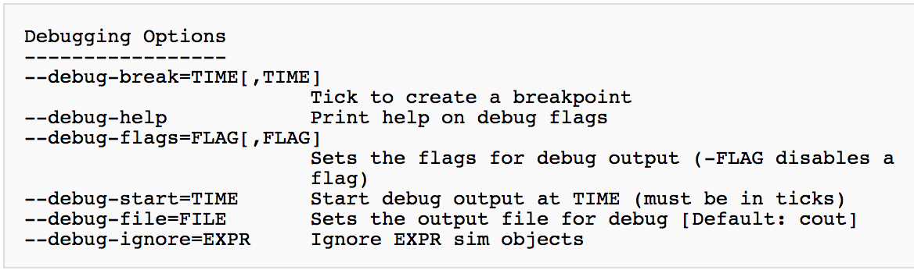
Gem5 Trace Based Debugging
To turn on the trace messages for a particular flag, use the --debug-flags command line argument
E.g. build/X86/gem5.opt --debug-flags=MemoryAccess --debug-file=trace.out configs/example/se.py -c [binary to Execute]

Slide 14
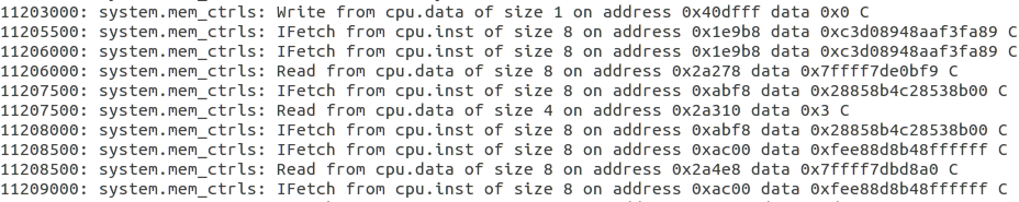
Simulation with Trace Based Debugging
Run gem5 with Trace Based debugging and give the binary file (download binary file Matmul and put it in gem5/)
build/X86/gem5.opt --debug-flags=MemoryAccess --debug-file=trace.out configs/example/se.py -c matmul
Output path of the trace is defaulted in m5out/. The trace file will have the following format:
Tick
Access Type
Address accessed
Matmul: https://github.com/paroque28/gem5_benchmark

Slide 15
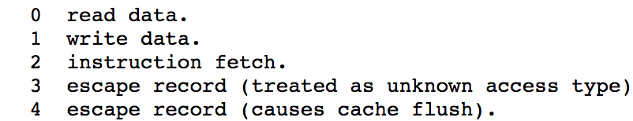
Dinero IV Simulation
To do trace-driven cache simulation using Dinero IV, we need to format trace for Dinero IV to accept
Dinero IV supports multiple input formats. For example, we can choose the din format
A din record is a two-tuple label address, where a tuple consists of the access type and the address accessed
The address is a hexadecimal byte-address without 0x starting, e.g. 0x40dff7 -> 40dff7
Tag of access type:

Slide 16
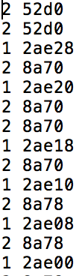
Format Transforming
Convert to din format
The output should be in din format
as follows
Then we can use Dinero IV to do the trace-driven cache simulation
Command of the baseline:
./dineroIV -l1-isize 8k -l1-iassoc 2 -l1-ibsize 16 -l1-irepl f -l1-dsize 8k -l1-dassoc 2 -l1-dbsize 16 -l1-drepl f -l1-dwalloc f -l1-dwback a -l1-dccc - informat d < Trace.din > baseline.out

Slide 17
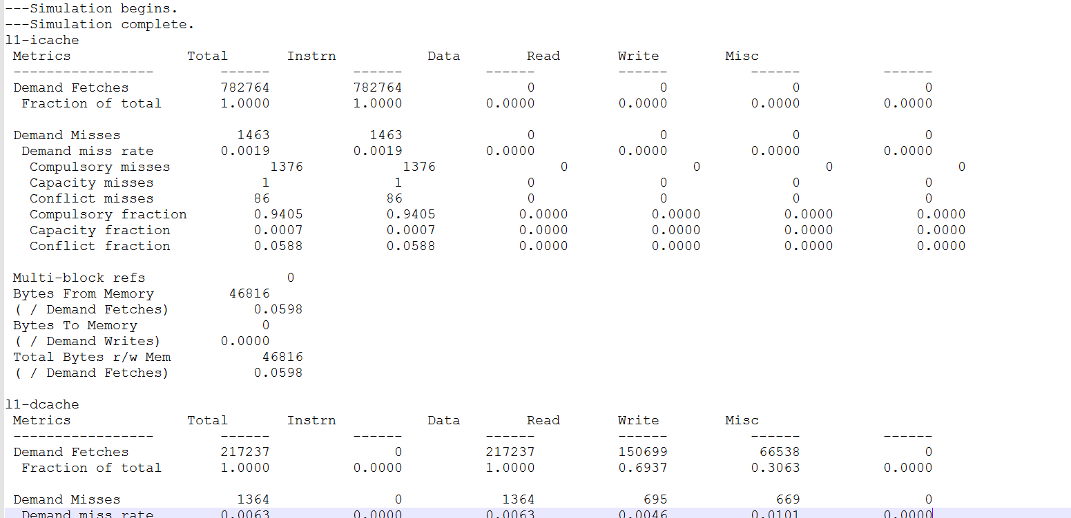
Simulation Results

